Slide 1
Entrepreneurship Environment

Slide 2
Entrepreneurship Environment
Environment - Sum total of external factors within which an enterprise operates.
Characteristics of environment:
Dynamic
Uncontrollable and external.
Poses threats and offers opportunities

Slide 3
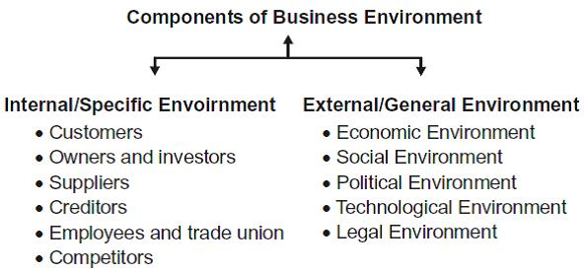
A PESTLE analysis is a simple tool that helps businesses succeed because it allows business owners to gain an understanding of the wider market in which they are operating in.

Slide 4
There are many companies the world over, that conduct PESTLE analysis on their brands in order to make strategies for the future or else to understand the market before launching them. It is a fundamental tool of market planning and strategizing that must be carried out to comprehend market trends and the systematic risks involved.
PESTLE analysis gives you an overview of the whole situation your business might be in.

Slide 5
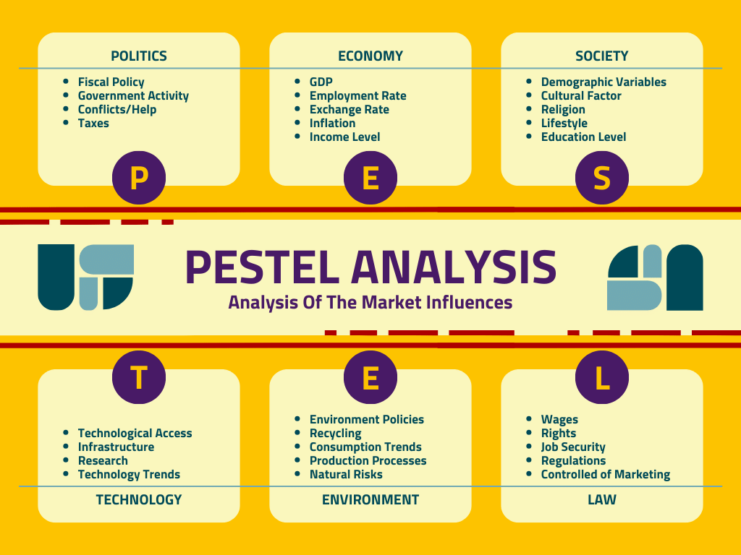

Slide 6
Class Activity
TAKE ANY INDUSTRY OF YOUR CHOICE AND DO PESTEL ANALYSIS.

